Slide 1

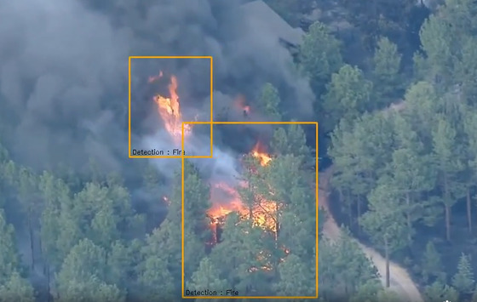
FireEye
Authors
Majd Zbedat SWE Department
Rani Khoury SWE Department
Supervisor
Dr.Zeev Frankel SWE Department
Capstone Project Phase 2
B-24-1-R-7
"AI-enhanced fire detection system using computer vision for real-time analysis of visual data, ensuring swift identification and mitigation of fire threats."
Notes:
Majd
Hello everyone, my name is Majd Zbedat and this is Rani Khoury in this presentation we are going to explain about our project that we worked on during last year- FireEye an AI-enhanced fire detection system
Our supervisor in this project is Dr. Zeev Frankel.
If you look at the picture we have a preview of how our system recognizes fires.

Slide 2
Outline
Background ---------------------------------------- 3
Problem ---------------------------------------------- 5
Solution ---------------------------------------------- 7
Use Case---------------------------------------------- 9
GUI----------------------------------------------------- 11
Challenges & Limitations -------------------------- 19
Demo------------------------------------------------------ 25
Testing plan---------------------------------------- 26
Conclusion ----------------------------------------- 27
Notes:
Majd
the presentation outline will be as follows :
We will present the background of our project
then we will talk about the problem and its solution
….
At the end we will show a short video that shows how the system works, then we have the conclusion that we ended up having

Slide 3
Background
Notes:
majd
In recent years, the world has observed a steady increase in forest fires, driven by a combination of climate change, human activities, and natural factors. These fires have not only resulted in catastrophic damage to ecosystems and wildlife but have also posed significant threats to human lives, and the overall environment.

Slide 4
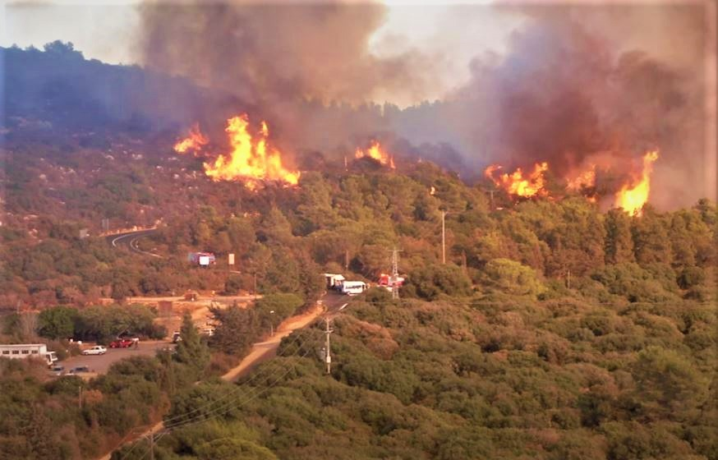
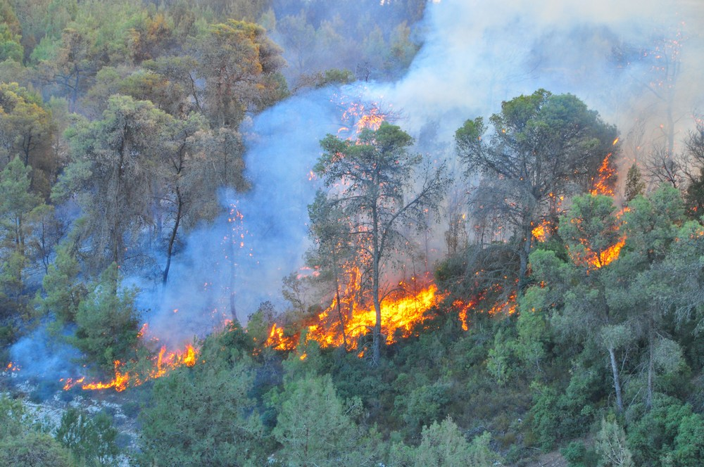
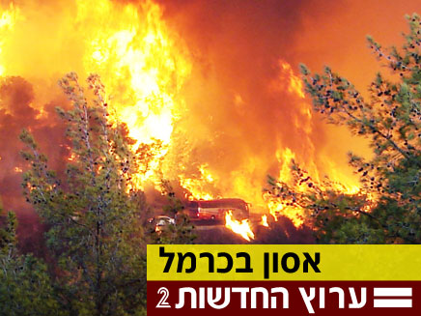
The Carmel fire 2010
Notes:
Majd
In these pictures we have an example of a fire that happened in the carmel in 2010 , because of the late detection of the fire and they did not know the behaviour of the fire in real time , they failed to extinguish the fire .

Slide 5
Problem

Slide 6
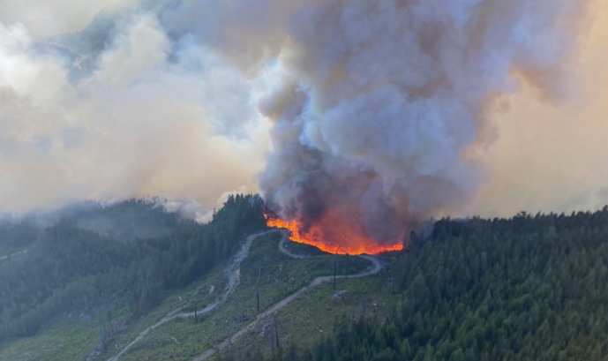
The growing severity of wildfires and the delays in their detection
Delay in detecting the fire
Inadequate wildfire detection
Systems.
Ecological imbalance
Expensive alternatives
Notes:
Majd
That the traditional fire detection methods, which often rely on human observation and basic sensor technologies, have proven inadequate in providing timely and accurate alerts, leading to delayed responses and greater devastation.

Slide 7
Solution

Slide 8

Fir Eye
AI-powered app to detect, analyze, and monitor fire incidents.
Notes:
Majd
Our FireEye project uses AI, machine learning, and high-definition video to improve fire detection. By integrating these advanced technologies into surveillance systems, we aim to enhance accuracy and speed, allowing for faster responses and reducing the impact of forest fires.

Slide 9

USE CASE
Diagram
Notes:
Majd
Now we will show the use case diagram of our project

Slide 10
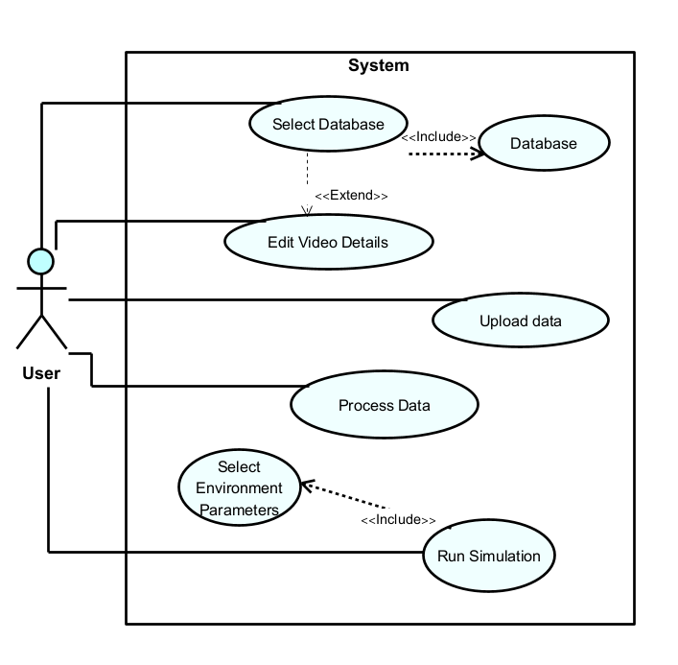
Notes:
Okay here we can see how our system should behave, we have only one user, and five main options, in the next slides we will show and explain each one of them.

Slide 11
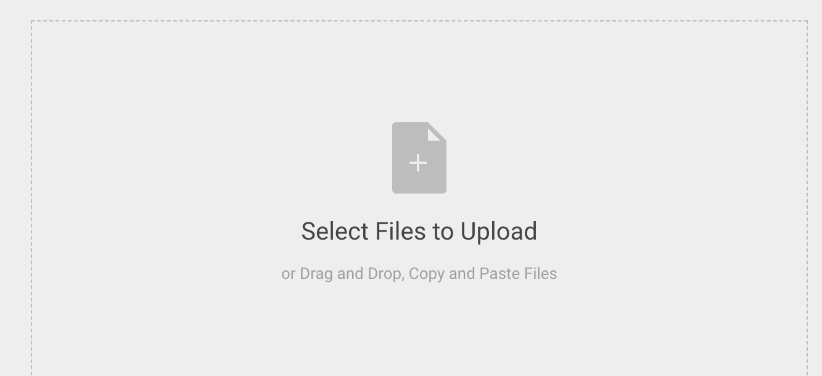

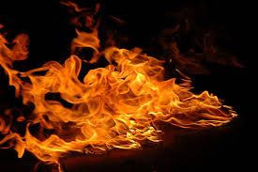
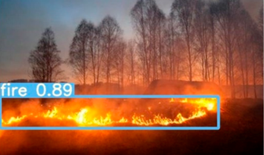
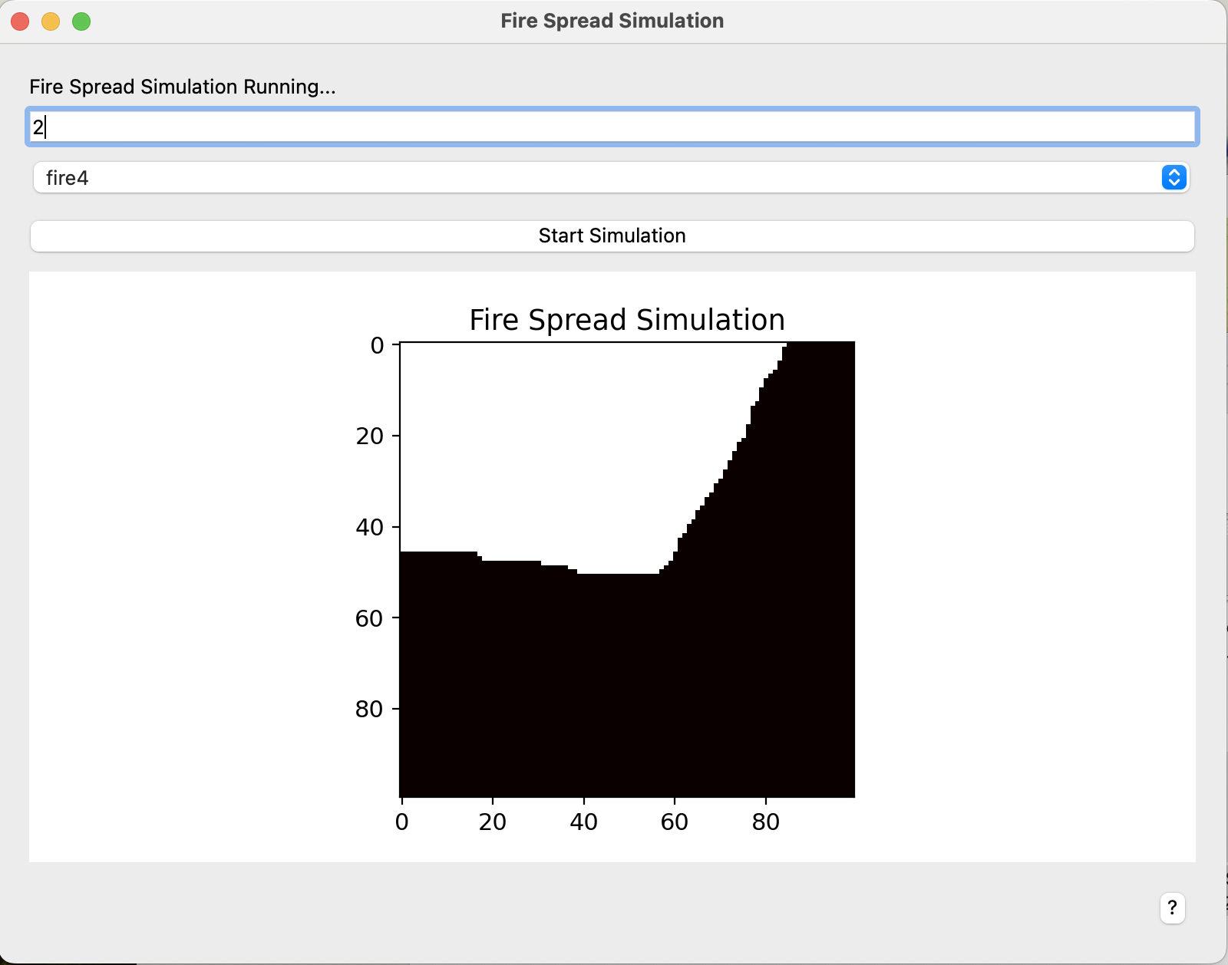
Real-Time Detection and Simulation Workflow
Select frame.
Preprocess frames (resize, normalize).
Feed frames into YOLOv5 model.
Process predictions (fire/no fire).
frame = cv2.VideoCapture(0)
preprocessed_frame = preprocess(frame)
prediction = model(preprocessed_frame)
process_prediction(prediction)
Notes:
cap = cv2.VideoCapture(0) # Use 0 for the default camera
prediction = model(preprocessed_frame) # Feed the frame into the YOLOv5 model and generate predictions
process_predictions(predictions) # Process predictions (ANALYZE) and trigger alerts if fire is detected

Slide 12

GUI
User interfaces

Slide 13
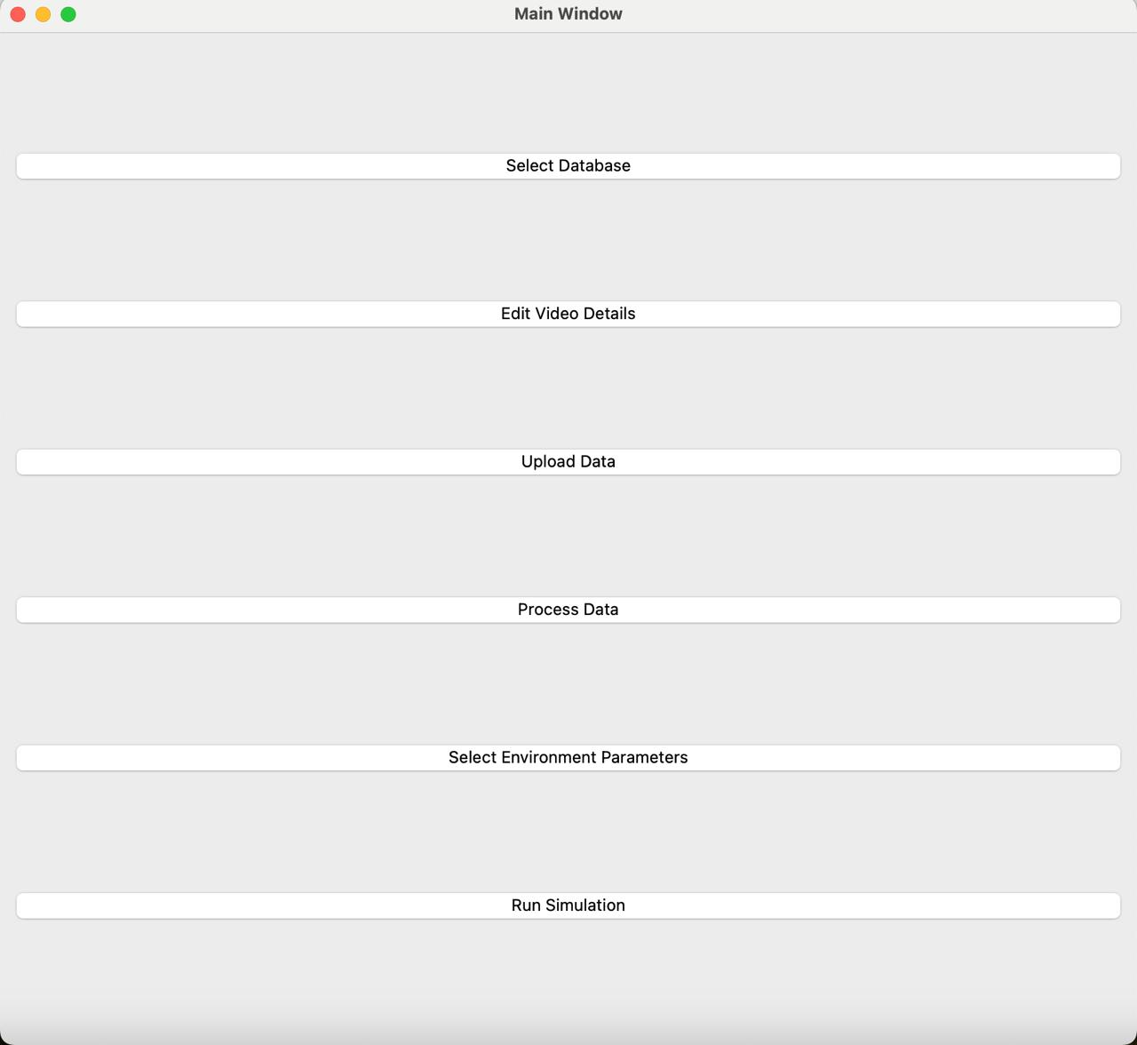
Main Page – The 6 main options:

Slide 14
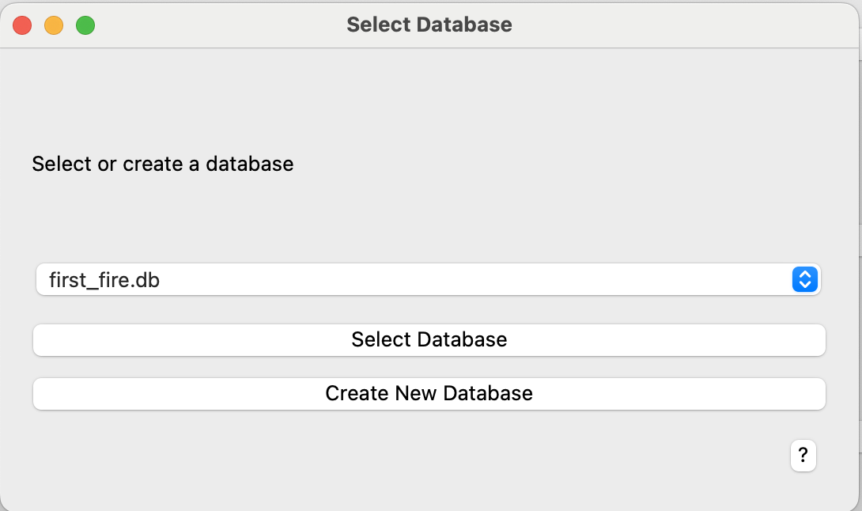
Database Page – selecting and connecting to DB

Slide 15
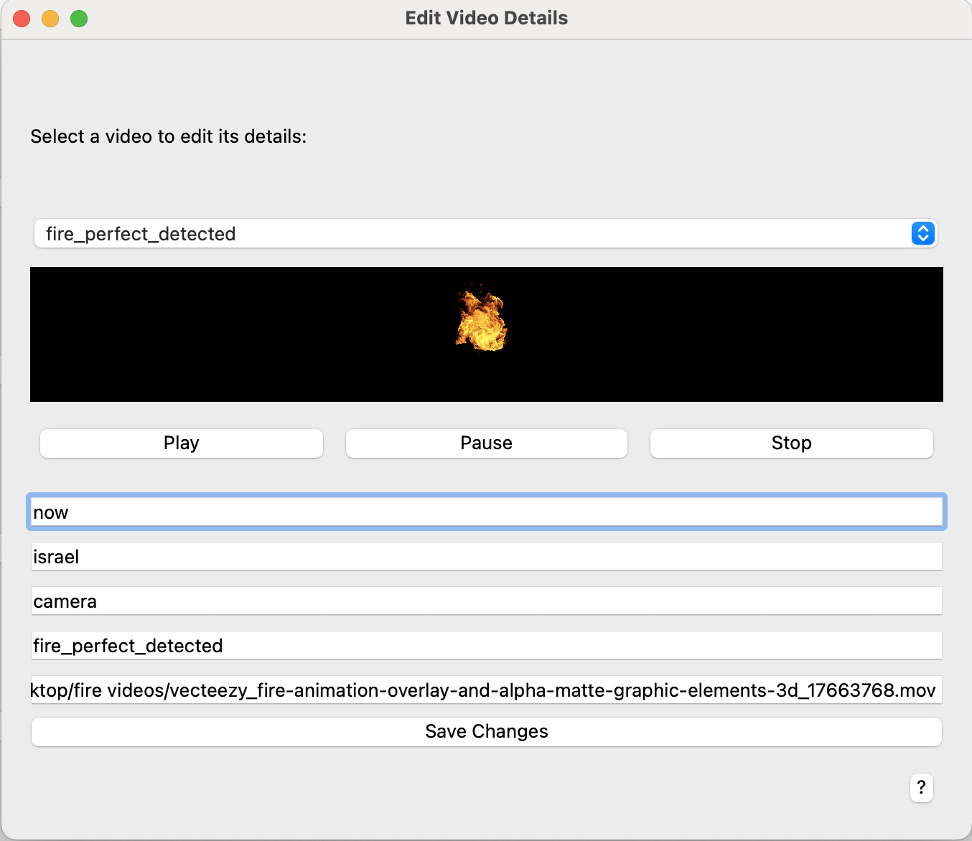
Edit video Page – editing video details:

Slide 16
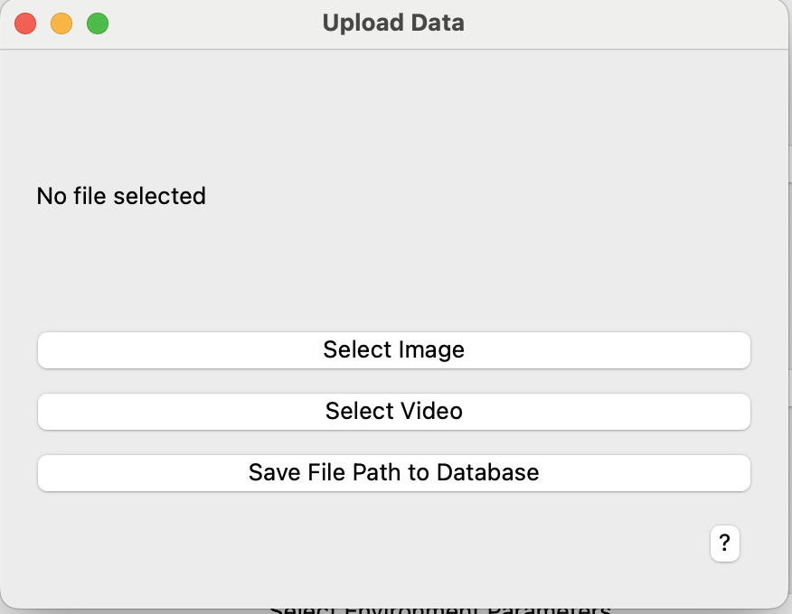
Upload Data - upload images or videos for fire detection

Slide 17
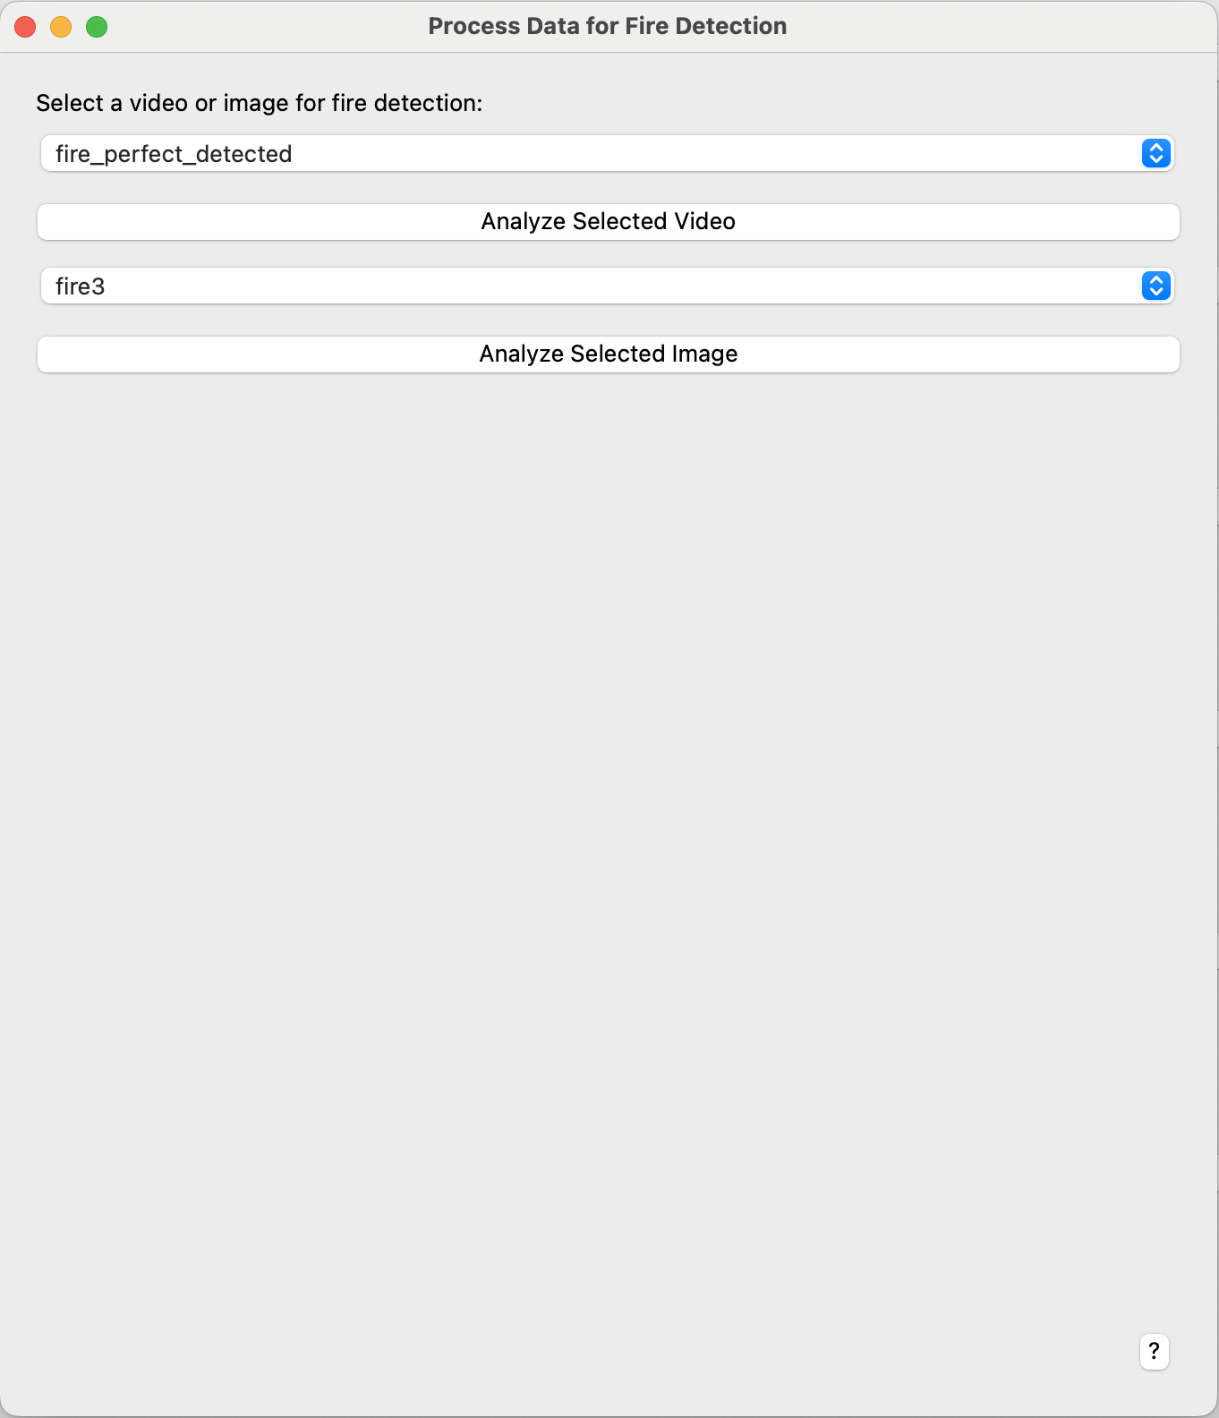
Process video – detecting fire in video !!!

Slide 18
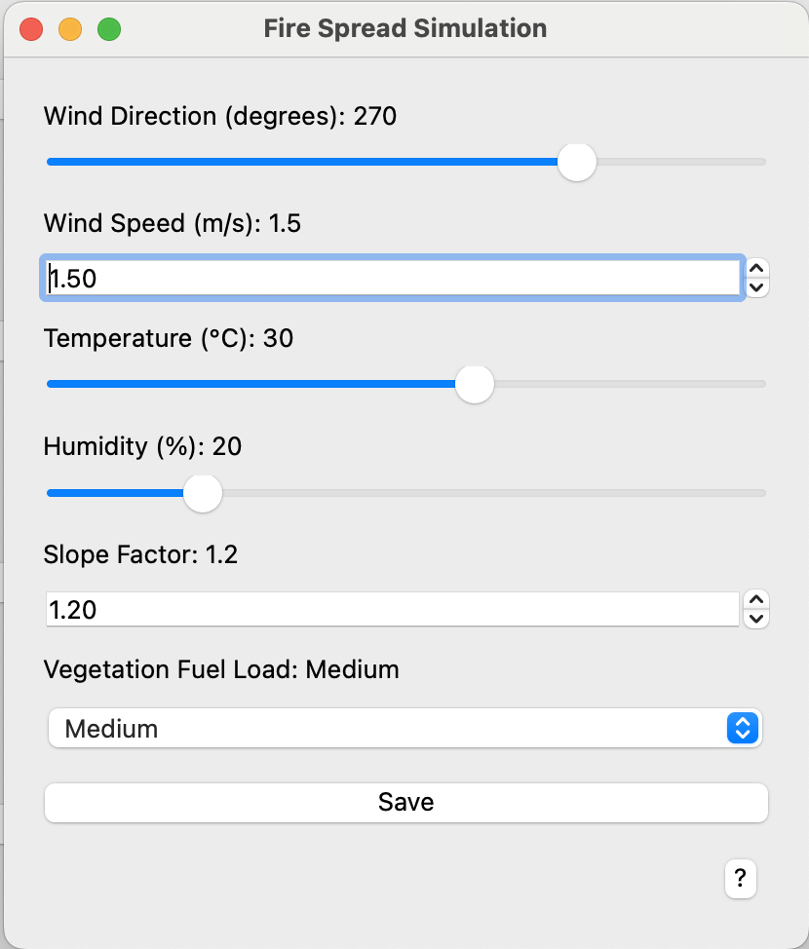
Fire Spread Simulation - set parameters

Slide 19
Fire Spread Simulation

Slide 20
Challenges

Slide 21
Challenges & Limitations
Complex Image-Processing Algorithm
Insufficient Data Sets
In the R&D Process

Slide 22
Challenge 1 Complex Image-Processing Algorithm
Masking & Color Detection isn’t enough
Contour Detection isn’t enough
We Pivoted to a New Hybrid Image-Processing Algorithm.

Slide 23

Challenge 2 Insufficient Data
Not Enough DataSet to train the model
We've collected data from various sources

Slide 24
Results

Slide 25
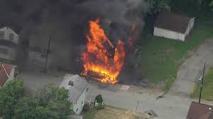
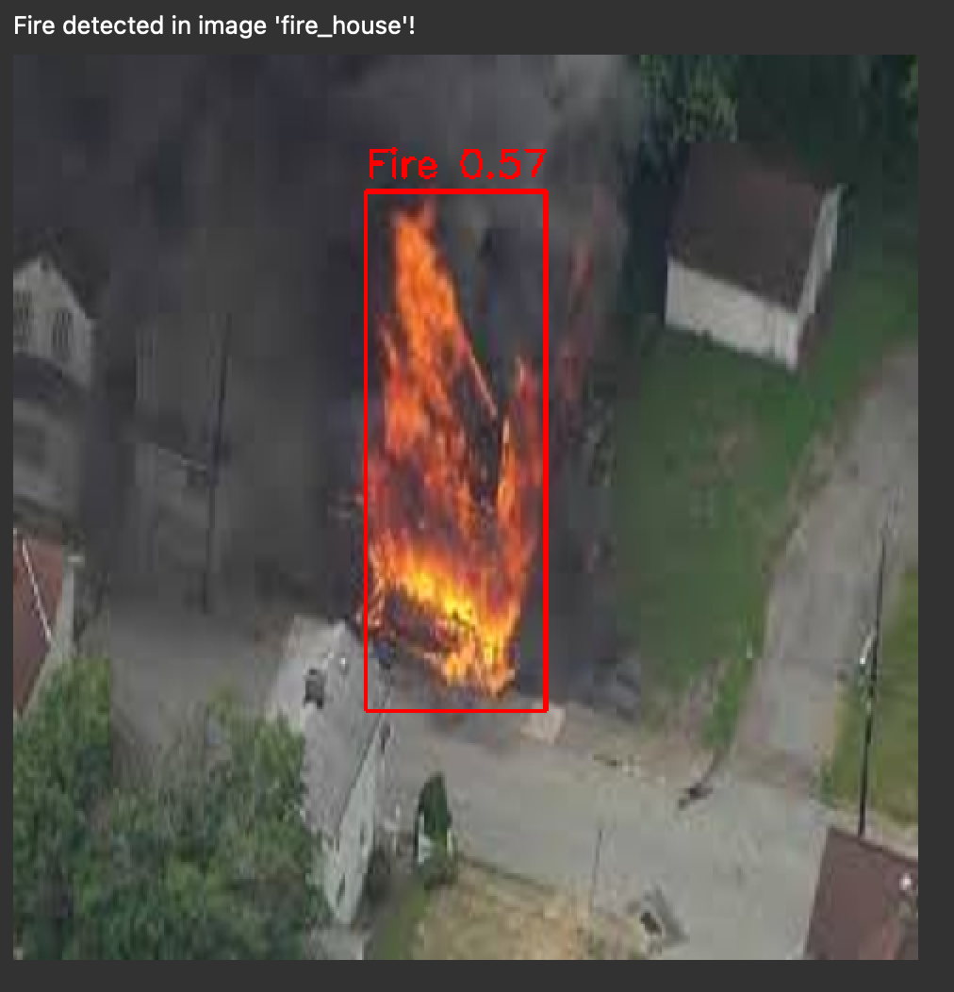
Sample 1
Do something like that
Fire detected
Notes:
Here we can algorithm. with medium to high accuracy.
As you can see, the algorithm draws square in fire detected successfully

Slide 26
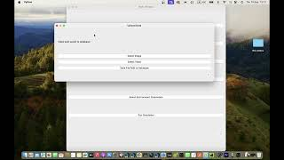
Demo - Check it out !
Notes:
Here we have a short video that shows how our system works.

Slide 27
Testing plan
Test | Actions | Result
Test GUI functionality | check GUI transactions, buttons etc. | getting expecting result and window switching
Test Input and output | checking input and output by entering a set of input. | In illegal input we got warning output, and in legal input we move to final result.
Test simple cases | entering simple cases input | got logical result
Notes:
There are three types of tests:
first, Test GUI functionality to check all transactions between GUI pages including buttons, files etc.
second, test input and output , by checking with set of inputs and getting output ,
third, testing our system with simple cases.

Slide 28
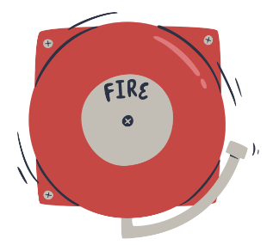
Conclusion
-We aim to maintain environmental balance, save people's lives and reduce many expenses for detecting fires
-Our system demonstrates high accuracy
and reliability

Slide 29

THANK YOU

